Slide 1
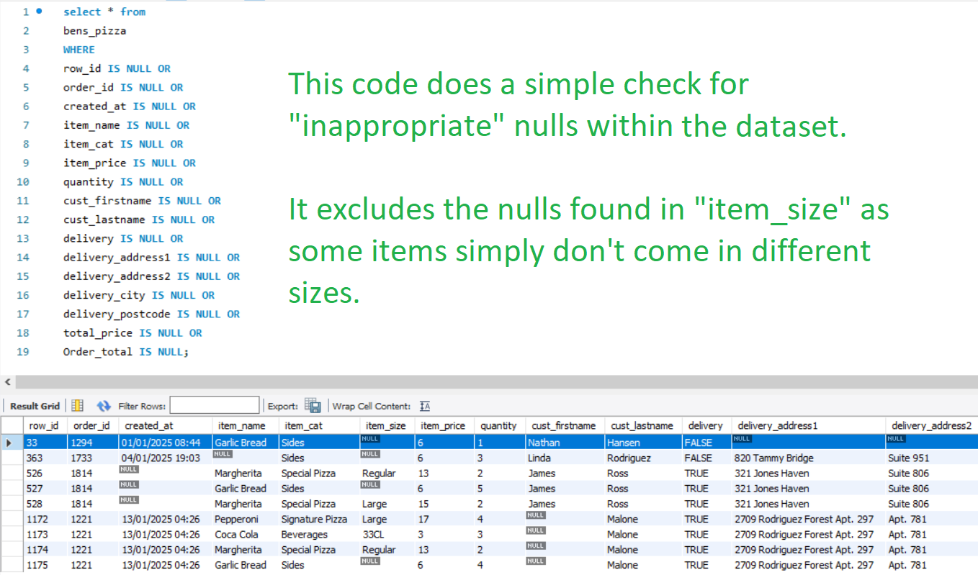
This code does a simple check for “inappropriate” nulls within the dataset. It excludes the nulls found in item_size as some items simply don’t come in different sizes.

Slide 2
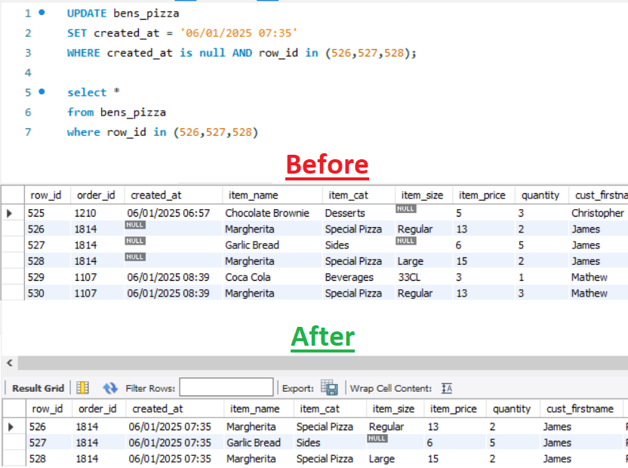
Since the data is chronological, I can assume the missing created_at will fall between the orders above and below it.

Slide 3
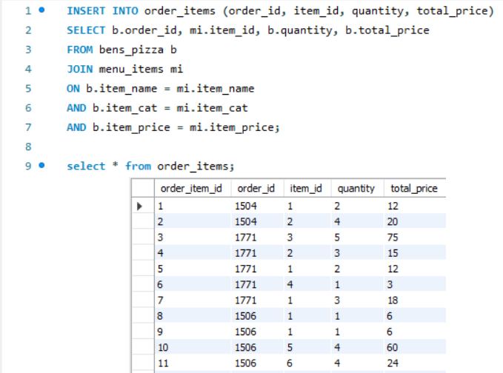
Populating my order_items table.

Slide 4
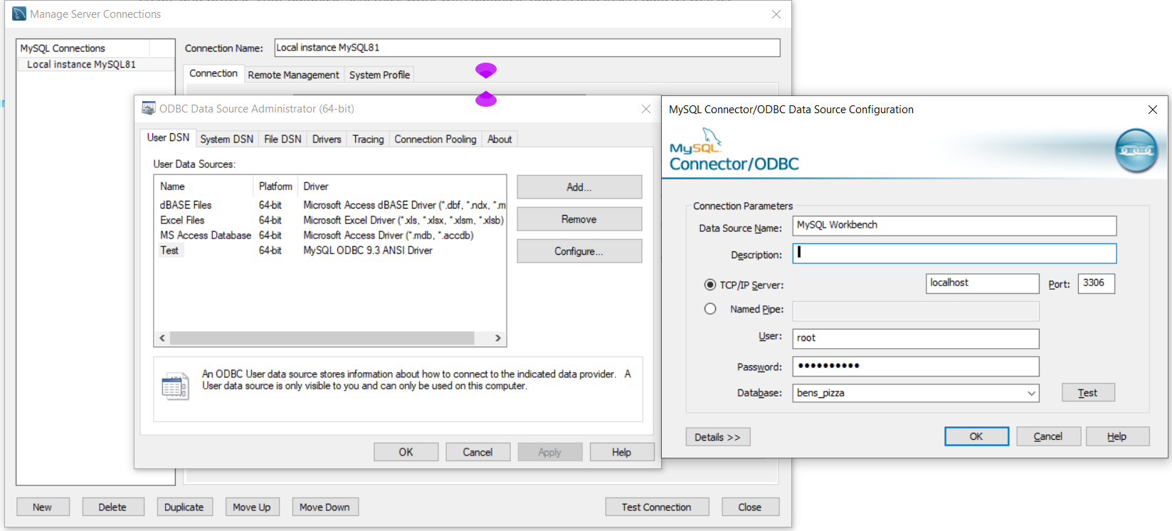
Troubleshooting the connection between MySQL workbench and Power BI.

Slide 5
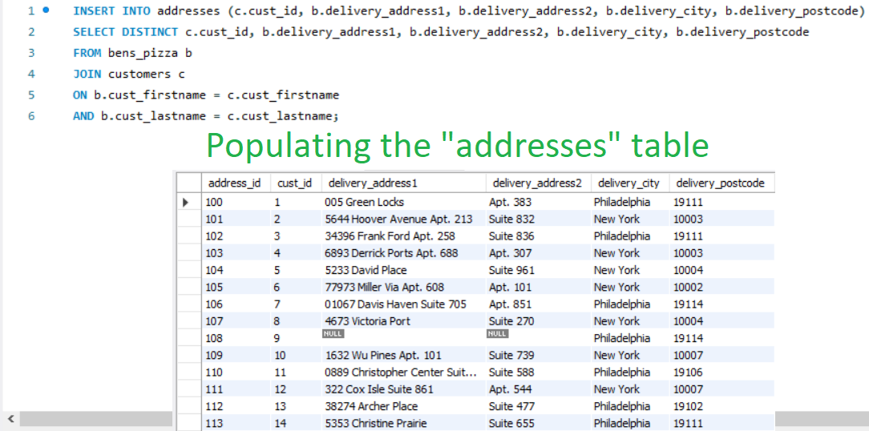
Populating the “Addresses” table

Slide 6
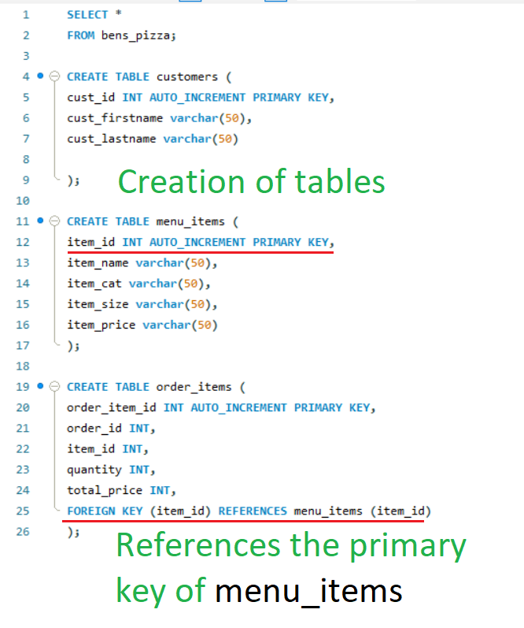

Slide 7
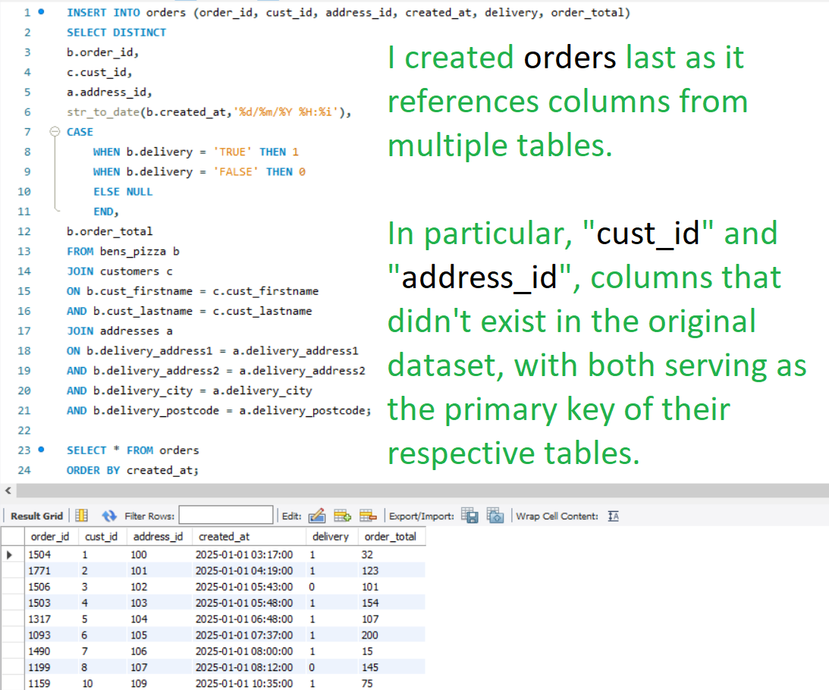

Slide 8
